Slide 1

Module 11: IPv4 Addressing
Introduction to Networks v7.0 (ITN)

Slide 2
Module Objectives
Module Title: IPv4 Addressing
Module Objective: Calculate an IPv4 subnetting scheme to efficiently segment your network.
Topic Title | Topic Objective
IPv4 Address Structure | Describe the structure of an IPv4 address including the network portion, the host portion, and the subnet mask.
IPv4 Unicast, Broadcast, and Multicast | Compare the characteristics and uses of the unicast, broadcast and multicast IPv4 addresses.
Types of IPv4 Addresses | Explain public, private, and reserved IPv4 addresses.
Network Segmentation | Explain how subnetting segments a network to enable better communication.
Subnet an IPv4 Network | Calculate IPv4 subnets for a /24 prefix.

Slide 3
11.1 IPv4 Address Structure

Slide 4
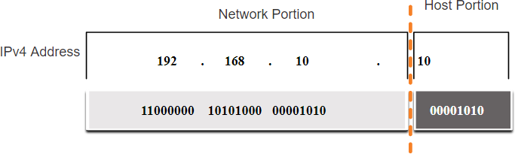
Network and Host Portions
IPv4 Address Structure
An IPv4 address is a 32-bit hierarchical address that is made up of a network portion and a host portion.
When determining the network portion versus the host portion, you must look at the
32-bit stream.
A subnet mask is used to determine the network and host portions.

Slide 5
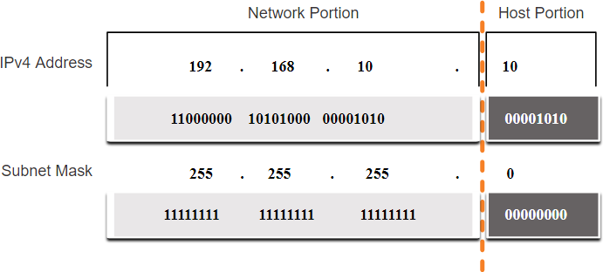
The Subnet Mask
IPv4 Address Structure
To identify the network and host portions of an IPv4 address, the subnet mask is compared to the IPv4 address bit for bit, from left to right.
The actual process used to identify the network and host portions is called ANDing.

Slide 6
The Prefix Length
IPv4 Address Structure
A prefix length is a less cumbersome method used to identify a subnet mask address.
The prefix length is the number of bits set to 1 in the subnet mask.
It is written in “slash notation” therefore, count the number of bits in the subnet mask and prepend it with a slash.
Subnet Mask | 32-bit Address | Prefix Length
255.0.0.0 | 11111111.00000000.00000000.00000000 | /8
255.255.0.0 | 11111111.11111111.00000000.00000000 | /16
255.255.255.0 | 11111111.11111111.11111111.00000000 | /24
255.255.255.128 | 11111111.11111111.11111111.10000000 | /25
255.255.255.192 | 11111111.11111111.11111111.11000000 | /26
255.255.255.224 | 11111111.11111111.11111111.11100000 | /27
255.255.255.240 | 11111111.11111111.11111111.11110000 | /28
255.255.255.248 | 11111111.11111111.11111111.11111000 | /29
255.255.255.252 | 11111111.11111111.11111111.11111100 | /30

Slide 7
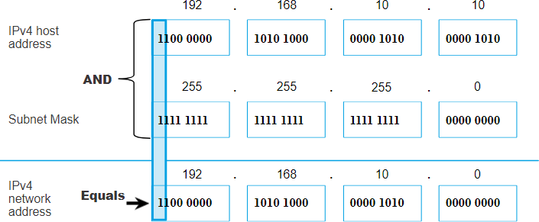
IPv4 Address Structure
Determining the Network: Logical AND
A logical AND Boolean operation is used in determining the network address.
Logical AND is the comparison of two bits where only a 1 AND 1 produces a 1 and any other combination results in a 0.
1 AND 1 = 1, 0 AND 1 = 0, 1 AND 0 = 0, 0 AND 0 = 0
1 = True and 0 = False
To identify the network address, the host IPv4 address is logically ANDed, bit by bit, with the subnet mask to identify the network address.

Slide 8
Video – Network, Host and Broadcast Addresses
IPv4 Address Structure
This video will cover the following:
Network address
Broadcast Address
First usable host
Last usable host

Slide 9
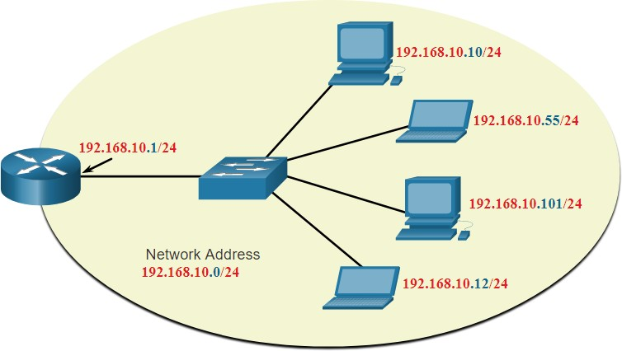
IPv4 Address Structure
Network, Host, and Broadcast Addresses
Within each network are three types of IP addresses:
Network address
Host addresses
Broadcast address
 | Network Portion | Host Portion | Host Bits
Subnet mask | 255 255 255 | 0
255.255.255.0 or /24 | 11111111 11111111 11111111 | 00000000
Network address | 192 168 10 | 0 | All 0s
192.168.10.0 or /24 | 11000000 10100000 00001010 | 00000000
First address | 192 168 10 | 1 | All 0s and a 1
192.168.10.1 or /24 | 11000000 10100000 00001010 | 00000001
Last address | 192 168 10 | 254 | All 1s and a 0
192.168.10.254 or /24 | 11000000 10100000 00001010 | 11111110
Broadcast address | 192 168 10 | 255 | All 1s
192.168.10.255 or /24 | 11000000 10100000 00001010 | 11111111

Slide 10
11.2 IPv4 Unicast, Broadcast, and Multicast

Slide 11
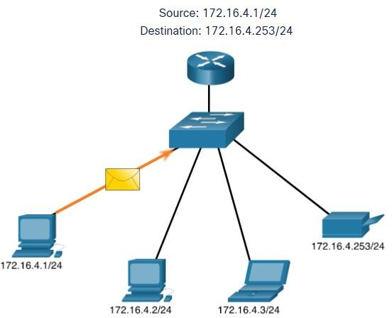
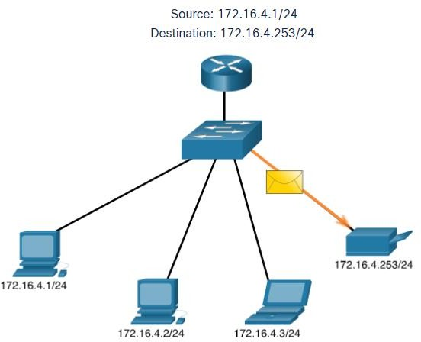

Unicast
IPv4 Unicast, Broadcast, and Multicast
Unicast transmission is sending a packet to one destination IP address.
For example, the PC at 172.16.4.1 sends a unicast packet to the printer at
172.16.4.253.

Slide 12
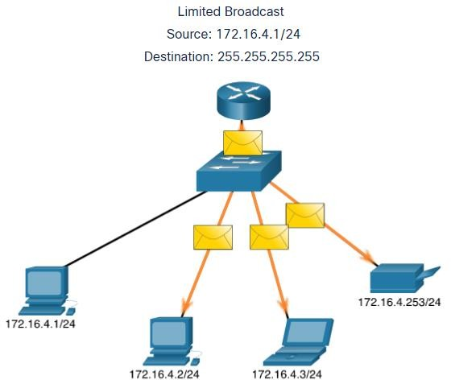
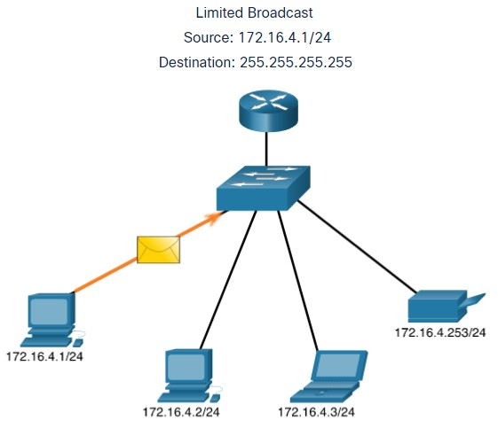

IPv4 Unicast, Broadcast, and Multicast
Broadcast
Broadcast transmission is sending a packet to all other destination IP addresses.
For example, the PC at 172.16.4.1 sends a broadcast packet to all IPv4 hosts.

Slide 13
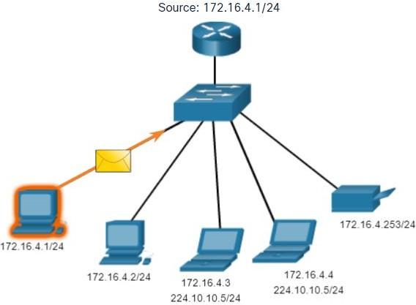
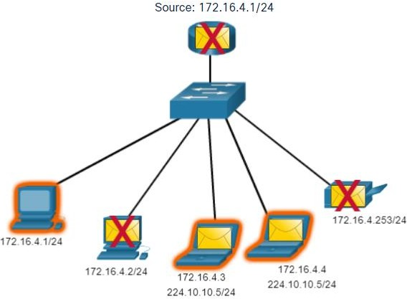

Multicast
IPv4 Unicast, Broadcast, and Multicast
Multicast transmission is sending a packet to a multicast address group.
For example, the PC at 172.16.4.1 sends a multicast packet to the multicast group
address 224.10.10.5.

Slide 14
11.3 Types of IPv4 Addresses

Slide 15
Public and Private IPv4 Addresses
Types of IPv4 Addresses
As defined in in RFC 1918, public IPv4 addresses are globally routed between internet service provider (ISP) routers.
Private addresses are common blocks of addresses used by most organizations to assign IPv4 addresses to internal hosts.
Private IPv4 addresses are not unique and can be used internally within any network.
However, private addresses are not globally routable.
Network Address and Prefix | RFC 1918 Private Address Range
10.0.0.0/8 | 10.0.0.0 - 10.255.255.255
172.16.0.0/12 | 172.16.0.0 - 172.31.255.255
192.168.0.0/16 | 192.168.0.0 - 192.168.255.255

Slide 16
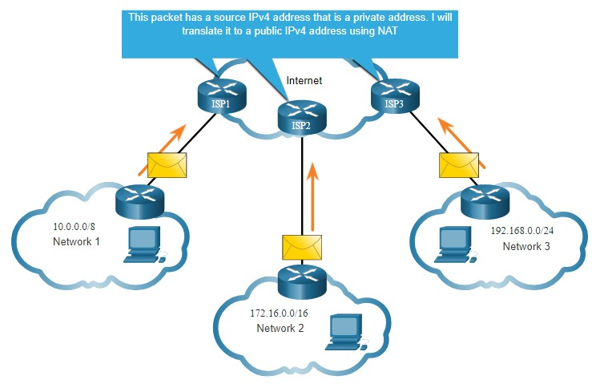
Routing to the Internet
Types of IPv4 Addresses
Network Address Translation (NAT) translates private IPv4 addresses to public IPv4 addresses.
NAT is typically enabled on the edge router connecting to the internet.
It translates the internal private address to a public global IP address.

Slide 17

Special Use IPv4 Addresses
Types of IPv4 Addresses
Loopback addresses
127.0.0.0 /8 (127.0.0.1 to 127.255.255.254)
Commonly identified as only 127.0.0.1
Used on a host to test if TCP/IP is operational.
Link-Local addresses
169.254.0.0 /16 (169.254.0.1 to 169.254.255.254)
Commonly known as the Automatic Private IP Addressing (APIPA) addresses or self-
assigned addresses.
Used by Windows DHCP clients to self-configure when no DHCP servers are available.

Slide 18
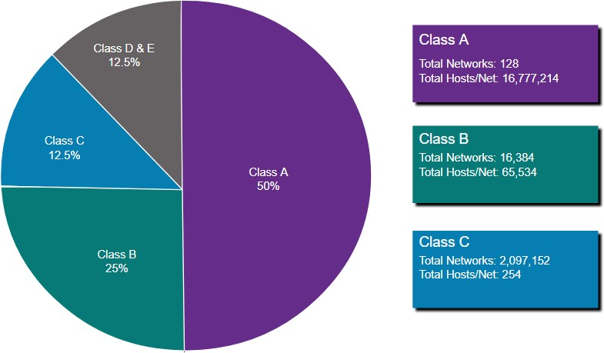
Legacy Classful Addressing
Types of IPv4 Addresses
RFC 790 (1981) allocated IPv4 addresses in classes
Class A (0.0.0.0/8 to 127.0.0.0/8)
Class B (128.0.0.0 /16 – 191.255.0.0 /16)
Class C (192.0.0.0 /24 – 223.255.255.0 /24)
Class D (224.0.0.0 to 239.0.0.0)
Class E (240.0.0.0 – 255.0.0.0)
Classful addressing wasted many IPv4
addresses.
Classful address allocation was replaced with classless addressing which ignores the rules of classes (A, B, C).

Slide 19
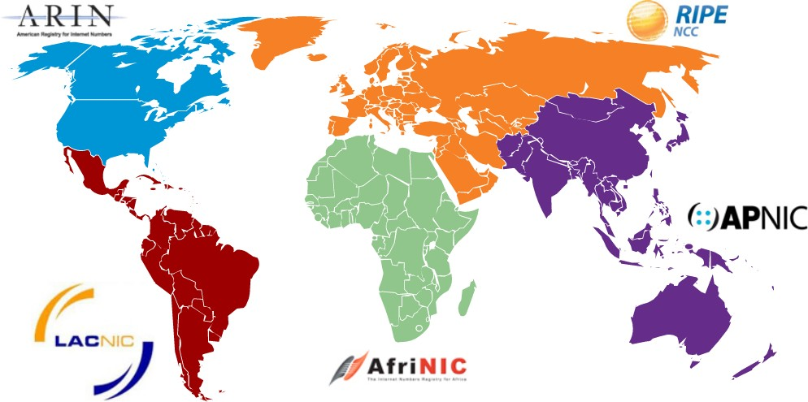
Assignment of IP Addresses
Types of IPv4 Addresses
The Internet Assigned Numbers Authority (IANA) manages and allocates blocks of IPv4 and IPv6 addresses to five Regional Internet Registries (RIRs).
RIRs are responsible for allocating IP addresses to ISPs who provide IPv4 address blocks to smaller ISPs and organizations.

Slide 20
11.4 Network Segmentation

Slide 21
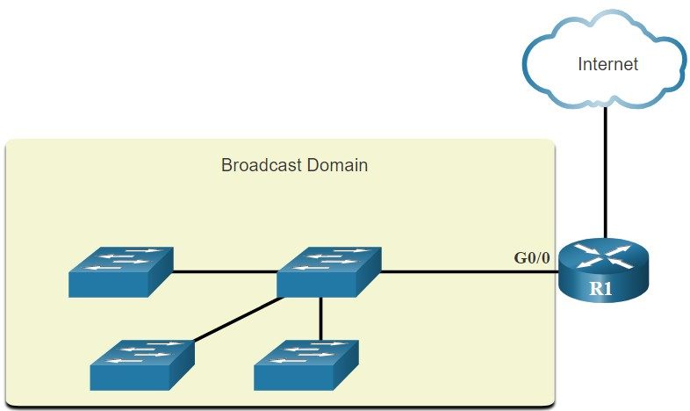
Broadcast Domains and Segmentation
Network Segmentation
Many protocols use broadcasts or multicasts (e.g., ARP use broadcasts to locate other devices, hosts send DHCP discover broadcasts to locate a DHCP server.)
Switches propagate broadcasts out all interfaces except the interface on which it was
received.
The only device that stops broadcasts is a router.
Routers do not propagate
broadcasts.
Each router interface connects to a broadcast domain and broadcasts are only propagated within that specific broadcast domain.

Slide 22
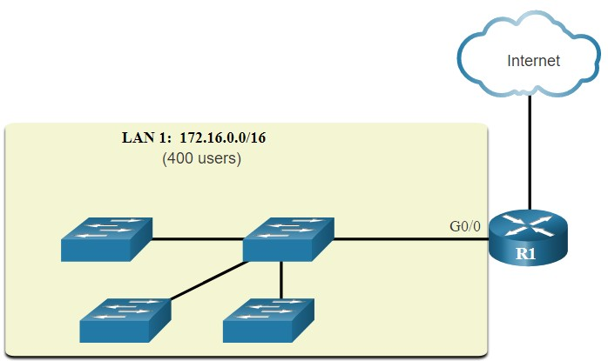
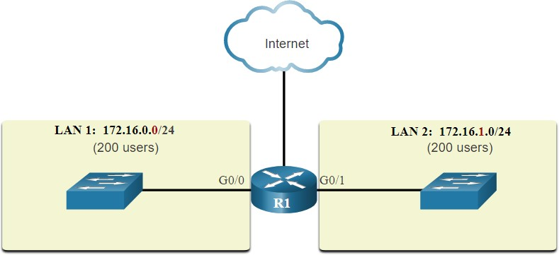
Problems with Large Broadcast Domains
Network Segmentation
A problem with a large broadcast domain is that these hosts can generate excessive broadcasts and negatively affect the network.
The solution is to reduce the size of the network to create smaller broadcast domains in a process called subnetting.
Dividing the network address 172.16.0.0 /16 into two subnets of 200 users each: 172.16.0.0
/24 and 172.16.1.0 /24.
Broadcasts are only propagated within the
smaller broadcast domains.

Slide 23



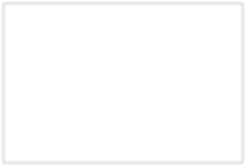
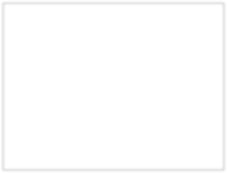
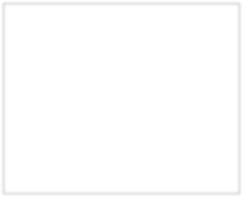
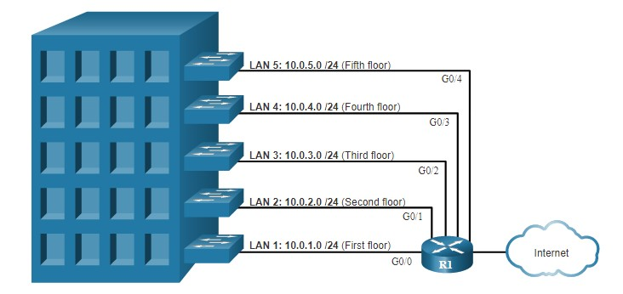
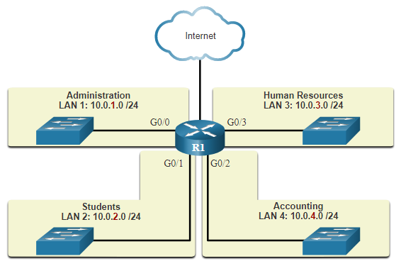
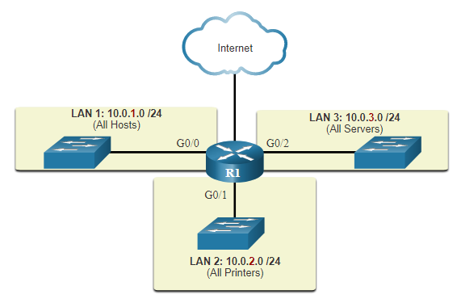
Network Segmentation
Reasons for Segmenting Networks
Subnetting reduces overall network traffic and improves network performance.
It can be used to implement security policies between subnets.
Subnetting reduces the number of devices affected by abnormal broadcast traffic.
Subnets are used for a variety of reasons including by:
Location
Group or Function
Device Type

Slide 24
11.5 Subnet an IPv4 Network

Slide 25
Subnet an IPv4 Network
Subnet on an Octet Boundary
Networks are most easily subnetted at the octet boundary of /8, /16, and /24.
Notice that using longer prefix lengths decreases the number of hosts per subnet.
Prefix Length | Subnet Mask | Subnet Mask in Binary (n = network, h = host) | # of hosts
/8 | 255.0.0.0 | nnnnnnnn.hhhhhhhh.hhhhhhhh.hhhhhhhh 11111111.00000000.00000000.00000000 | 16,777,214
/16 | 255.255.0.0 | nnnnnnnn.nnnnnnnn.hhhhhhhh.hhhhhhhh 11111111.11111111.00000000.00000000 | 65,534
/24 | 255.255.255.0 | nnnnnnnn.nnnnnnnn.nnnnnnnn.hhhhhhhh 11111111.11111111.11111111.00000000 | 254

Slide 26
Subnet an IPv4 Network
Subnet on an Octet Boundary (Cont.)
In the first table 10.0.0.0/8 is subnetted using /16 and in the second table, a /24 mask.
Subnet Address (256 Possible Subnets) | Host Range (65,534 possible hosts per subnet) | Broadcast
10.0.0.0/16 | 10.0.0.1 - 10.0.255.254 | 10.0.255.255
10.1.0.0/16 | 10.1.0.1 - 10.1.255.254 | 10.1.255.255
10.2.0.0/16 | 10.2.0.1 - 10.2.255.254 | 10.2.255.255
10.3.0.0/16 | 10.3.0.1 - 10.3.255.254 | 10.3.255.255
10.4.0.0/16 | 10.4.0.1 - 10.4.255.254 | 10.4.255.255
10.5.0.0/16 | 10.5.0.1 - 10.5.255.254 | 10.5.255.255
10.6.0.0/16 | 10.6.0.1 - 10.6.255.254 | 10.6.255.255
10.7.0.0/16 | 10.7.0.1 - 10.7.255.254 | 10.7.255.255
... | ... | ...
10.255.0.0/16 | 10.255.0.1 - 10.255.255.254 | 10.255.255.255
Subnet Address (65,536 Possible Subnets) | Host Range (254 possible hosts per subnet) | Broadcast
10.0.0.0/24 | 10.0.0.1 - 10.0.0.254 | 10.0.0.255
10.0.1.0/24 | 10.0.1.1 - 10.0.1.254 | 10.0.1.255
10.0.2.0/24 | 10.0.2.1 - 10.0.2.254 | 10.0.2.255
… | … | …
10.0.255.0/24 | 10.0.255.1 - 10.0.255.254 | 10.0.255.255
10.1.0.0/24 | 10.1.0.1 - 10.1.0.254 | 10.1.0.255
10.1.1.0/24 | 10.1.1.1 - 10.1.1.254 | 10.1.1.255
10.1.2.0/24 | 10.1.2.1 - 10.1.2.254 | 10.1.2.255
… | … | …
10.100.0.0/24 | 10.100.0.1 - 10.100.0.254 | 10.100.0.255
... | ... | ...
10.255.255.0/24 | 10.255.255.1 - 10.2255.255.254 | 10.255.255.255

Slide 27
Subnet an IPv4 Network
Subnet within an Octet Boundary
Refer to the table to see six ways to subnet a /24 network.
Prefix Length | Subnet Mask | Subnet Mask in Binary (n = network, h = host) | # of subnets | # of hosts
/25 | 255.255.255.128 | nnnnnnnn.nnnnnnnn.nnnnnnnn.nhhhhhhh 11111111.11111111.11111111.10000000 | 2 | 126
/26 | 255.255.255.192 | nnnnnnnn.nnnnnnnn.nnnnnnnn.nnhhhhhh 11111111.11111111.11111111.11000000 | 4 | 62
/27 | 255.255.255.224 | nnnnnnnn.nnnnnnnn.nnnnnnnn.nnnhhhhh 11111111.11111111.11111111.11100000 | 8 | 30
/28 | 255.255.255.240 | nnnnnnnn.nnnnnnnn.nnnnnnnn.nnnnhhhh 11111111.11111111.11111111.11110000 | 16 | 14
/29 | 255.255.255.248 | nnnnnnnn.nnnnnnnn.nnnnnnnn.nnnnnhhh 11111111.11111111.11111111.11111000 | 32 | 6
/30 | 255.255.255.252 | nnnnnnnn.nnnnnnnn.nnnnnnnn.nnnnnnhh 11111111.11111111.11111111.11111100 | 64 | 2

Slide 28
Subnet an IPv4 Network
Video – The Subnet Mask
This video will demonstrate the process of subnetting.

Slide 29
Subnet an IPv4 Network
Video – Subnet with the Magic Number
This video will demonstrate subnetting with the magic number.

Slide 30
Subnet an IPv4 Network
Packet Tracer – Subnet an IPv4 Network
In this Packet Tracer, you will do the following:
Design an IPv4 Network Subnetting Scheme
Configure the Devices
Test and Troubleshoot the Network

Slide 31
11.6 Subnet a Slash 16 and a Slash 8 Prefix

Slide 32
Subnet a Slash 16 and a Slash 8 Prefix
Create Subnets with a Slash 16 prefix
Prefix Length | Subnet Mask | Network Address (n = network, h = host) | # of subnets | # of hosts
/17 | 255.255.128.0 | nnnnnnnn.nnnnnnnn.nhhhhhhh.hhhhhhhh 11111111.11111111.10000000.00000000 | 2 | 32766
/18 | 255.255.192.0 | nnnnnnnn.nnnnnnnn.nnhhhhhh.hhhhhhhh 11111111.11111111.11000000.00000000 | 4 | 16382
/19 | 255.255.224.0 | nnnnnnnn.nnnnnnnn.nnnhhhhh.hhhhhhhh 11111111.11111111.11100000.00000000 | 8 | 8190
/20 | 255.255.240.0 | nnnnnnnn.nnnnnnnn.nnnnhhhh.hhhhhhhh 11111111.11111111.11110000.00000000 | 16 | 4094
/21 | 255.255.248.0 | nnnnnnnn.nnnnnnnn.nnnnnhhh.hhhhhhhh 11111111.11111111.11111000.00000000 | 32 | 2046
/22 | 255.255.252.0 | nnnnnnnn.nnnnnnnn.nnnnnnhh.hhhhhhhh 11111111.11111111.11111100.00000000 | 64 | 1022
/23 | 255.255.254.0 | nnnnnnnn.nnnnnnnn.nnnnnnnh.hhhhhhhh 11111111.11111111.11111110.00000000 | 128 | 510
/24 | 255.255.255.0 | nnnnnnnn.nnnnnnnn.nnnnnnnn.hhhhhhhh 11111111.11111111.11111111.00000000 | 256 | 254
/25 | 255.255.255.128 | nnnnnnnn.nnnnnnnn.nnnnnnnn.nhhhhhhh 11111111.11111111.11111111.10000000 | 512 | 126
/26 | 255.255.255.192 | nnnnnnnn.nnnnnnnn.nnnnnnnn.nnhhhhhh 11111111.11111111.11111111.11000000 | 1024 | 62
/27 | 255.255.255.224 | nnnnnnnn.nnnnnnnn.nnnnnnnn.nnnhhhhh 11111111.11111111.11111111.11100000 | 2048 | 30
/28 | 255.255.255.240 | nnnnnnnn.nnnnnnnn.nnnnnnnn.nnnnhhhh 11111111.11111111.11111111.11110000 | 4096 | 14
/29 | 255.255.255.248 | nnnnnnnn.nnnnnnnn.nnnnnnnn.nnnnnhhh 11111111.11111111.11111111.11111000 | 8192 | 6
/30 | 255.255.255.252 | nnnnnnnn.nnnnnnnn.nnnnnnnn.nnnnnnhh 11111111.11111111.11111111.11111100 | 16384 | 2
The table highlights all the possible scenarios for subnetting a /16 prefix.
© 2016 Cisco and/or its affiliates. All rights reserved
. Cisco Confidential
32

Slide 33
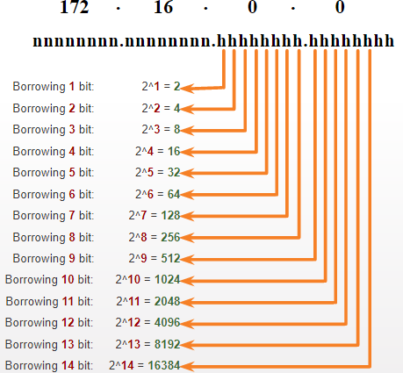
Create 100 Subnets with a Slash 16 prefix
Subnet a Slash 16 and a Slash 8 Prefix
Consider a large enterprise that requires at least 100 subnets and has chosen the private address 172.16.0.0/16 as its internal network address.
The figure displays the number of subnets that can be created when borrowing bits from the third octet and the fourth octet.
Notice there are now up to 14 host bits that can be
borrowed (i.e., last two bits cannot be borrowed).
To satisfy the requirement of 100 subnets for the enterprise, 7 bits (i.e., 2⁷ = 128 subnets) would need to be borrowed (for a total of 128 subnets).

Slide 34
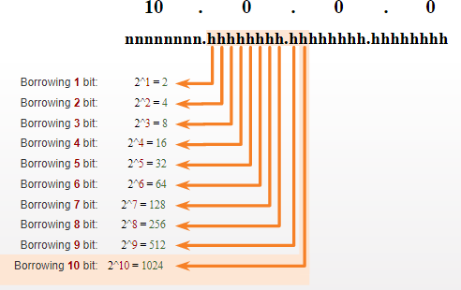
Subnet a Slash 16 and a Slash 8 Prefix
Create 1000 Subnets with a Slash 8 prefix
Consider a small ISP that requires 1000 subnets for its clients using network address 10.0.0.0/8 which means there are 8 bits in the network portion and 24 host bits available to borrow toward subnetting.
The figure displays the number of subnets that can be created when borrowing bits from the second and third.
Notice there are now up to 22 host bits that can be borrowed (i.e., last two bits cannot be borrowed).
To satisfy the requirement of 1000 subnets for the enterprise, 10 bits (i.e., 2¹⁰=1024 subnets) would need to be borrowed (for a total of 128 subnets)

Slide 35
Subnet a Slash 16 and a Slash 8 Prefix
Video – Subnet Across Multiple Octets
This video will demonstrate creating subnets across multiple octets.

Slide 36
Lab – Calculate IPv4 Subnets
Subnet a Slash 16 and a Slash 8 Prefix
In this lab, you will complete the following objectives:
Part 1: Determine IPv4 Address Subnetting
Part 2: Calculate IPv4 Address Subnetting

Slide 37
11.7 Subnet to Meet Requirements

Slide 38
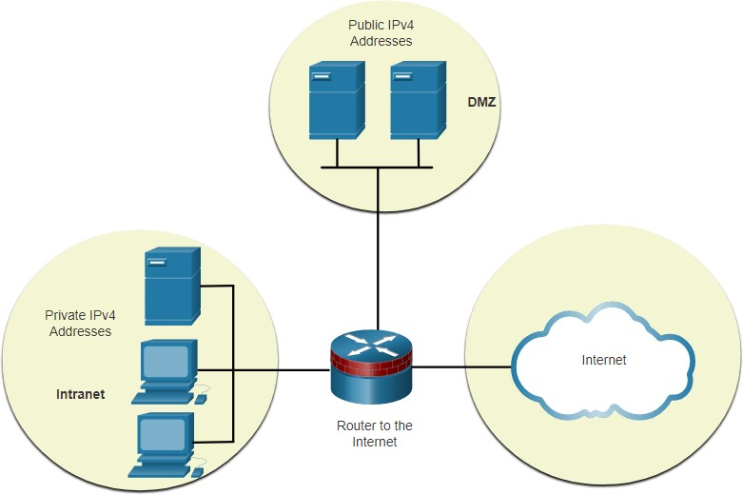
Subnet Private versus Public IPv4 Address Space
Subnet to Meet Requirements
Enterprise networks will have an:
Intranet - A company’s internal network typically using private IPv4 addresses.
DMZ – A companies internet facing servers.
Devices in the DMZ use public IPv4 addresses.
A company could use the 10.0.0.0/8 and subnet
on the /16 or /24 network boundary.
The DMZ devices would have to be configured with public IP addresses.

Slide 39
Subnet to Meet Requirements
Minimize Unused Host IPv4 Addresses and Maximize Subnets
There are two considerations when planning subnets:
The number of host addresses required for each network
The number of individual subnets needed
Prefix Length | Subnet Mask | Subnet Mask in Binary (n = network, h = host) | # of subnets | # of hosts
/25 | 255.255.255.128 | nnnnnnnn.nnnnnnnn.nnnnnnnn.nhhhhhhh 11111111.11111111.11111111.10000000 | 2 | 126
/26 | 255.255.255.192 | nnnnnnnn.nnnnnnnn.nnnnnnnn.nnhhhhhh 11111111.11111111.11111111.11000000 | 4 | 62
/27 | 255.255.255.224 | nnnnnnnn.nnnnnnnn.nnnnnnnn.nnnhhhhh 11111111.11111111.11111111.11100000 | 8 | 30
/28 | 255.255.255.240 | nnnnnnnn.nnnnnnnn.nnnnnnnn.nnnnhhhh 11111111.11111111.11111111.11110000 | 16 | 14
/29 | 255.255.255.248 | nnnnnnnn.nnnnnnnn.nnnnnnnn.nnnnnhhh 11111111.11111111.11111111.11111000 | 32 | 6
/30 | 255.255.255.252 | nnnnnnnn.nnnnnnnn.nnnnnnnn.nnnnnnhh 11111111.11111111.11111111.11111100 | 64 | 2

Slide 40
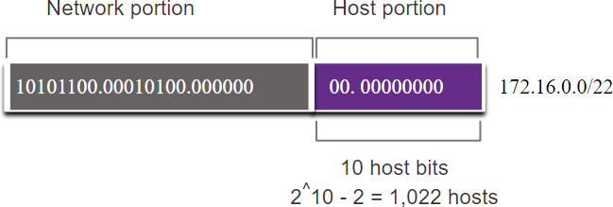
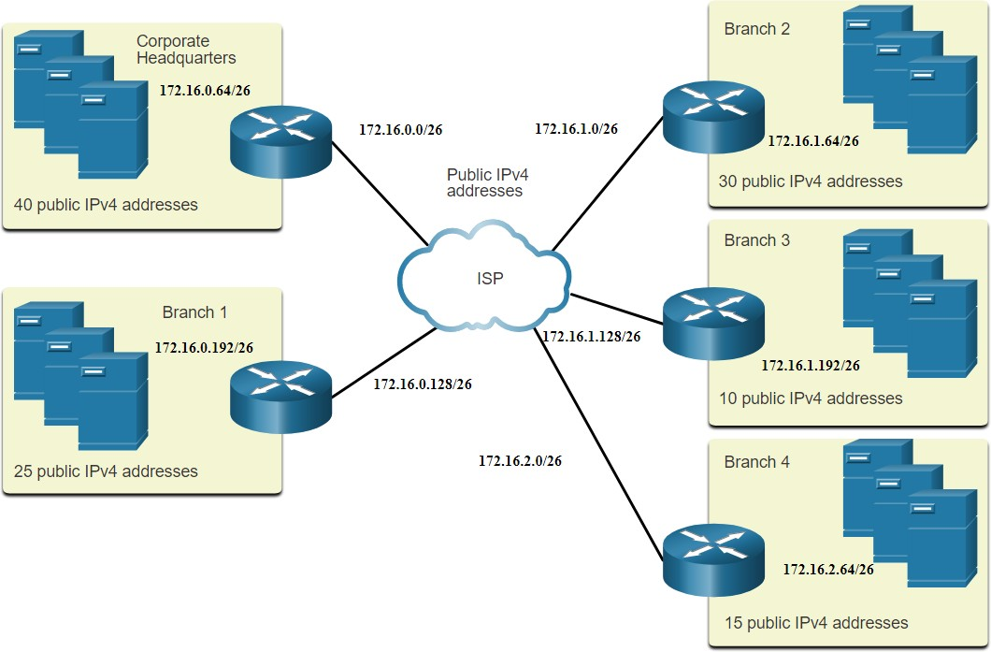
Example: Efficient IPv4 Subnetting
Subnet to Meet Requirements
In this example, corporate headquarters has been allocated a public network address of 172.16.0.0/22 (10 host bits) by its ISP providing 1,022 host addresses.
There are five sites and therefore five internet connections which means the organization requires 10 subnets with the largest subnet requires 40 addresses.
It allocated 10 subnets with a /26 (i.e.,
255.255.255.192) subnet mask.

Slide 41
Subnet to Meet Requirements
Packet Tracer – Subnetting Scenario
In this Packet Tracer, you will do the following:
Design an IP Addressing Scheme
Assign IP Addresses to Network Devices and Verify Connectivity

Slide 42
11.8 VLSM

Slide 43
Video – VLSM Basics
VLSM
This video will explain VLSM basics.

Slide 44
VLSM
Video – VLSM Example
This video will demonstrate creating subnets specific to the needs of the network.

Slide 45
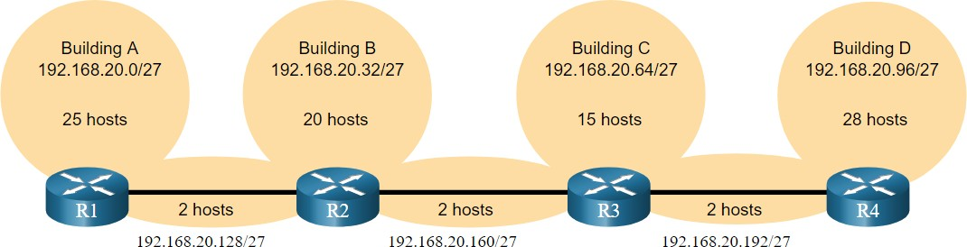
IPv4 Address Conservation
VLSM
Given the topology, 7 subnets are required (i.e, four LANs and three WAN links) and the largest number of host is in Building D with 28 hosts.
A /27 mask would provide 8 subnets of 30 host IP addresses and therefore support
this topology.

Slide 46
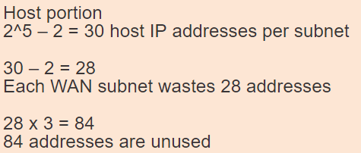
IPv4 Address Conservation (Cont.)
VLSM
However, the point-to-point WAN links only require two addresses and therefore waste 28 addresses each for a total of 84 unused addresses.
Applying a traditional subnetting scheme to this scenario is not very efficient and is
wasteful.
VLSM was developed to avoid wasting addresses by enabling us to subnet a subnet.

Slide 47
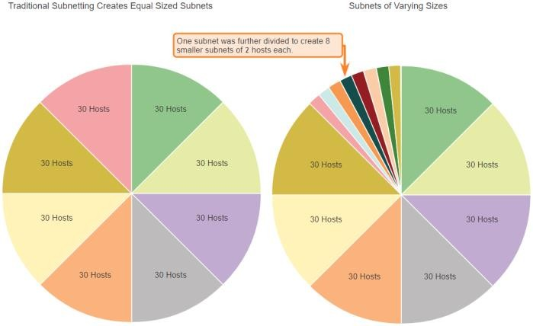
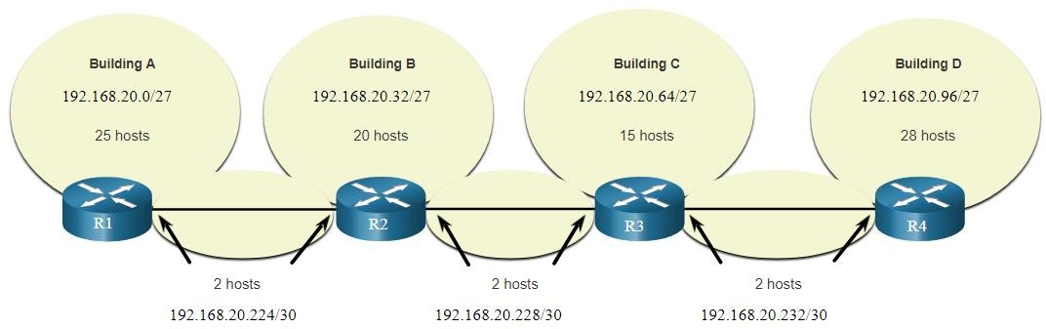
VLSM
VLSM
The left side displays the traditional subnetting scheme (i.e., the same subnet mask) while the right side illustrates how VLSM can be used to subnet a subnet and divided the last subnet into eight /30 subnets.
When using VLSM, always begin by satisfying the host requirements of the largest subnet and continue subnetting until the host requirements of the smallest subnet are satisfied.
The resulting topology with VLSM applied.

Slide 48
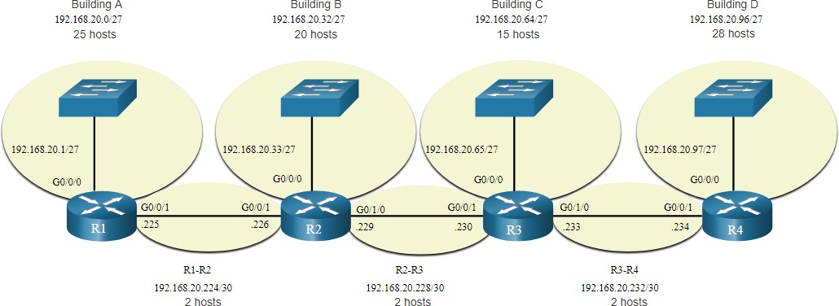
VLSM
VLSM Topology Address Assignment
Using VLSM subnets, the LAN and inter-router networks can be addressed without unnecessary waste as shown in the logical topology diagram.

Slide 49
11.9 Structured Design

Slide 50
Structured Design
IPv4 Network Address Planning
IP network planning is crucial to develop a scalable solution to an enterprise network.
To develop an IPv4 network wide addressing scheme, you need to know how many subnets are needed, how many hosts a particular subnet requires, what devices are part of the subnet, which parts of your network use private addresses, and which use public, and many other determining factors.
Examine the needs of an organization’s network usage and how the subnets will be structured.
Perform a network requirement study by looking at the entire network to determining how each area will be segmented.
Determine how many subnets are needed and how many hosts per subnet.
Determine DHCP address pools and Layer 2 VLAN pools.

Slide 51
Structured Design
Device Address Assignment
Within a network, there are different types of devices that require addresses:
End user clients – Most use DHCP to reduce errors and burden on network support staff. IPv6 clients can obtain address information using DHCPv6 or SLAAC.
Servers and peripherals – These should have a predictable static IP address.
Servers that are accessible from the internet – Servers must have a public IPv4 address, most often accessed using NAT.
Intermediary devices – Devices are assigned addresses for network management, monitoring, and security.
Gateway – Routers and firewall devices are gateway for the hosts in that network.
When developing an IP addressing scheme, it is generally recommended that you have a set pattern of how addresses are allocated to each type of device.

Slide 52
Structured Design
Packet Tracer – VLSM Design and Implementation Practice
In this Packet Tracer, you will do the following:
Examine the Network Requirements
Design the VLSM Addressing Scheme
Assign IP Addresses to Devices and Verify Connectivity

Slide 53
11.10 Module Practice and Quiz

Slide 54
Structured Design
Packet Tracer – Design and Implement a VLSM Addressing Scheme
In this Packet Tracer, you will do the following:
Design a VLSM IP addressing scheme given requirements
Configure addressing on network devices and hosts
Verify IP connectivity
Troubleshoot connectivity issues as required.

Slide 55
Lab - Design and Implement a VLSM Addressing Scheme
Structured Design
In this lab, you will complete the following objectives:
Examine Network Requirements
Design the VLSM Address Scheme
Cable and Configure the IPv4 Network

Slide 56
What did I learn in this module?
Module Practice and Quiz
The IP addressing structure consists of a 32-bit hierarchical network address that identifies a network and a host portion. Network devices use a process called ANDing using the IP address and associated subnet mask to identify the network and host portions.
Destination IPv4 packets can be unicast, broadcast, and multicast.
There are globally routable IP addresses as assigned by the IANA and there are three ranges of private IP network addresses that cannot be routed globally but can be used on all internal private networks.
Reduce large broadcast domains using subnets to create smaller broadcast domains, reduce
overall network traffic, and improve network performance.
Create IPv4 subnets using one or more of the host bits as network bits. However, networks are most easily subnetted at the octet boundary of /8, /16, and /24.
Larger networks can be subnetted at the /8 or /16 boundaries.
Use VLSM to reduce the number of unused host addresses per subnet.

Slide 57
What did I learn in this module? (Cont.)
Module Practice and Quiz
VLSM allows a network space to be divided into unequal parts. Always begin by satisfying the host requirements of the largest subnet. Continue subnetting until the host requirements of the smallest subnet are satisfied.
When designing a network addressing scheme, consider internal, DMZ, and external requirements. Use a consistent internal IP addressing scheme with a set pattern of how addresses are allocated to each type of device.

Slide 58


